Slide 1
Air-BnB Recommendation System
Group 7
Wong Xin Pei
Candy Lim
Tan Jun Xian

Slide 2
Agenda
Objective
Data
Algorithms
Evaluation
Conclusion
What do want to accomplish?
Exploration
Pre-Processing
Word Embeddings / Vectorization
Visualization of results
Recommend user’s preferred Airbnb with the most accuracy as possible.
PCA + TensorBoard
TF-IDF
Doc2Vec
Cosine-Similarity
K-NN
Cosine-Similarity

Slide 3
Objective
Name | Description | Availability
User
Input

Slide 4
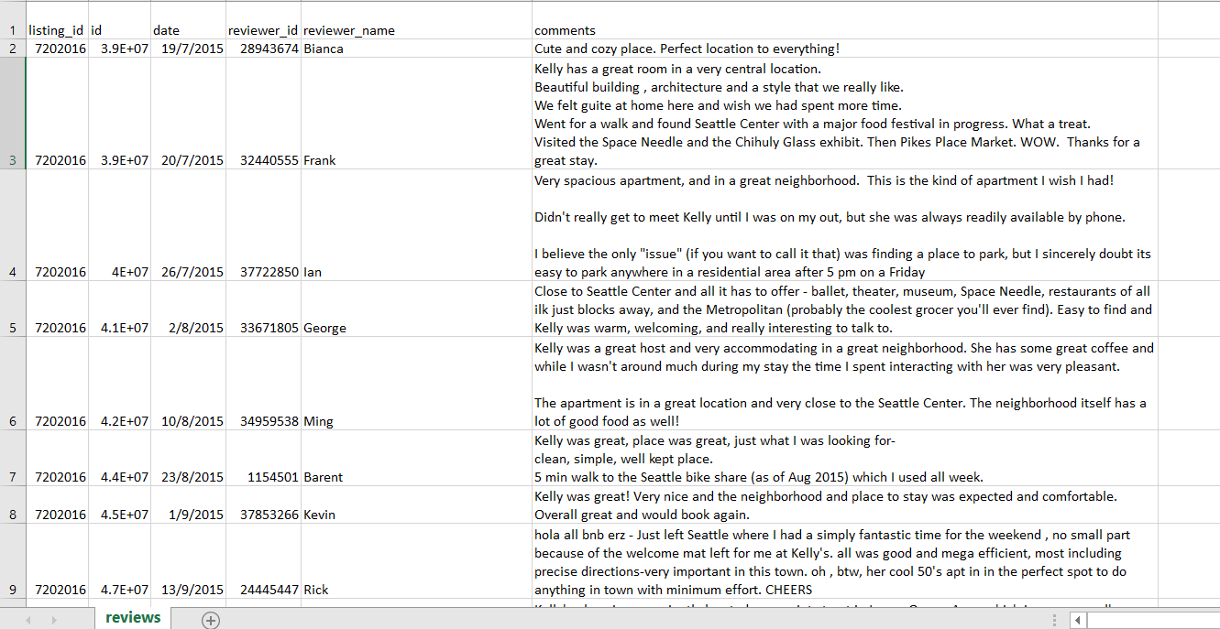
Data
In the dataset, there exists written reviews of the Airbnb. We decided to use these text data to aid in recommending the user what they want.
Displaying map location of airbnb.
Calculating positive of negative score.
Additional
We also decided to include simple filters for the dataset we have, where users can just select what attributes they want their room to have. E.g Number of beds
Text
Raw filters

Slide 5
TF-IDF Cosine-Similarity K-NN Doc2Vec

Slide 6
Word Embeddings/Vectorization
Vector representations (numbers) of a word
Process huge text data
For Machine Learning algorithms
User Input
I want big rooms
X1
House has big rooms
 | I | Want | Big | Rooms | House | has | many | small
User Input | 1 | 1 | 1 | 1 | 0 | 0 | 0 | 0
X1 | 0 | 0 | 1 | 1 | 1 | 1 | 0 | 0
X2 | 0 | 0 | 0 | 1 | 0 | 0 | 1 | 1
X2
Many small rooms

Slide 7
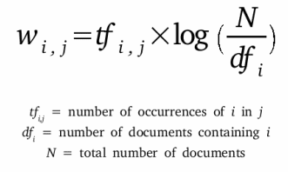
TF-IDF
Term Frequency - Inverse Document Frequency
term = word
Number of times a term (t) appeared in a doc (d)
Total number of docs (d)
*
Total number of docs (n)
Number of documents with the term (t) + 1
Log
Process of giving a word a numeric value (w)
Determines how important the word is, in the document

Slide 8
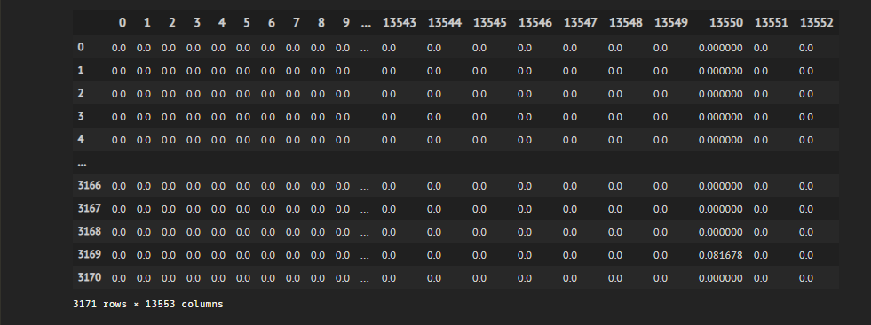

Slide 9
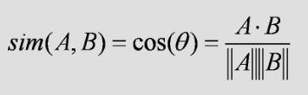
Cosine-Similarity
Determine how similar words/documents are regardless of magnitude
Where A and B are vector representations of words/documents
Since angle is small,
Similarity value will be high
Exactly same,
Similarity value will be 1
Similarity value will be 0
A
A
A
A
B
B

Slide 10
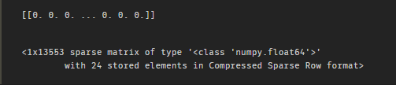
User Input:
I want a big and cozy room and a nice house. It must be near the downtown area for easy access. It must also have an amazing view of the city.
Calculate Cosine Similarity of
User vs Each of every listing

Slide 11
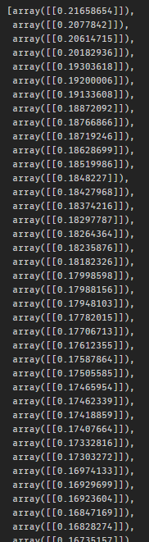
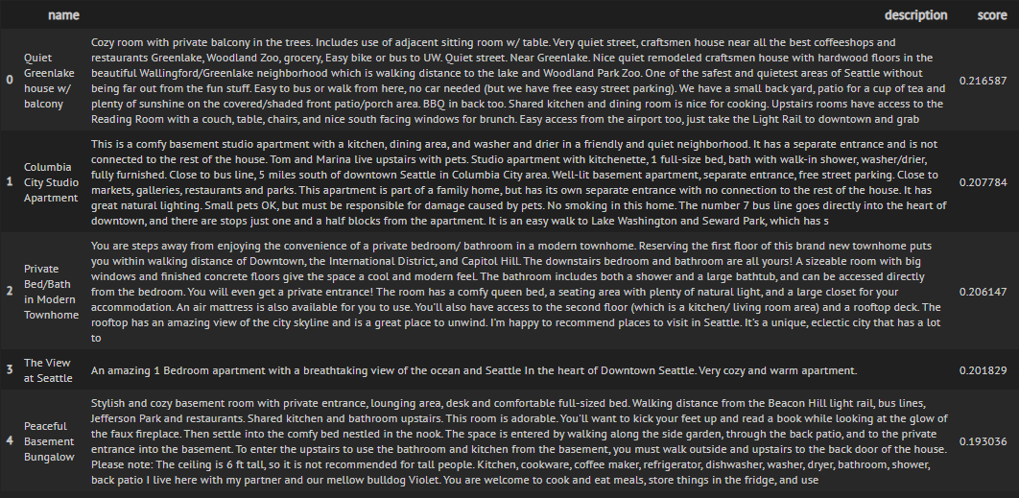
Cosine Similarity Values
User Input:
I want a big and cozy room and a nice house. It must be near the downtown area for easy access. It must also have an amazing view of the city.

Slide 12
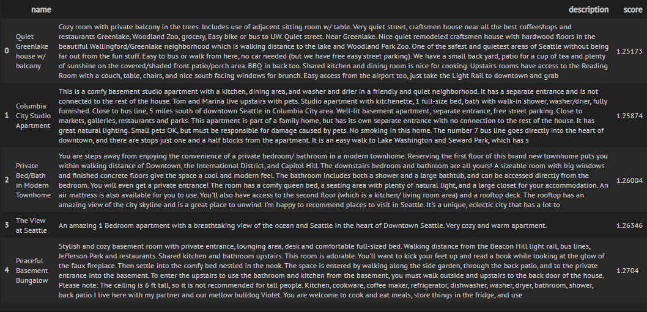
K-NN
Since we know our documents/listings are vectors
Points on graph
Find Nearest Neighbors of “User-Input point” -> Using Euclidean

Slide 13
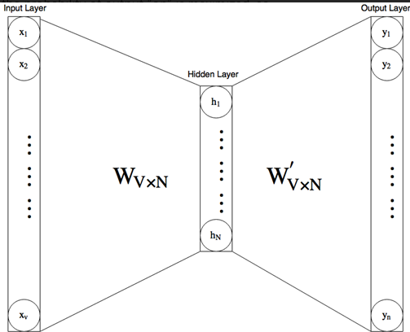
Doc2Vec (PV-DM)
Word2Vec (Skip-Gram, Window-Size=2)
Group similar words together
User Input:
I want a big and cozy room and a nice house. It must be near the downtown area for easy access. It must also have an amazing view of the city.
Simple 2-layer neural network
Training Pairs
Word2Vec
Input | Target
I | want
I | a
want | I
want | a
a | want
a | big
I want a big and cozy room and a nice house.
I want a big and cozy room and a nice house.
I want a big and cozy room and a nice house.
I want a big and cozy room and a nice house.
.
.

Slide 14
Training Pairs
Input | One-hot | Target | One-hot
I | [1, 0, 0 ,0] | want | [0, 1, 0 ,0]
I | [1, 0, 0 ,0] | a | [0, 0, 1 ,0]
want | [0, 1, 0 ,0] | I | [1, 0, 0 ,0]
want | [0, 1, 0 ,0] | a | [0, 0, 1 ,0]
a | [0, 0, 1 ,0] | want | [0, 1, 0 ,0]
a | [0, 0, 1 ,0] | big | [0, 0, 0, 1]
Input | Target
I | want
I | a
want | I
want | a
a | want
a | big
Output
Target
Input
Hidden
0.1
0
1
w1
want
I
0
0.8
1
w2
0
0.1
0
0
w3
0
0

Slide 15
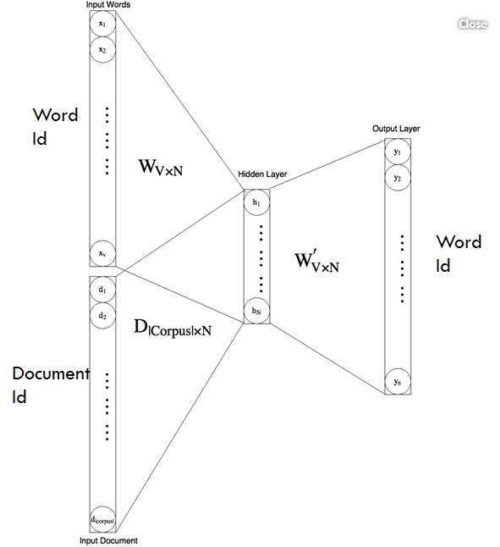
(Known)
Input Matrix
(Hidden)
Weight Matrix
Target
X
=
Like
a * x = c
Find x
Doc2Vec
Unique Word | embedding
I | [1,1]
want | [2,2]
a | [1,3]
big | [2,3]

Slide 16
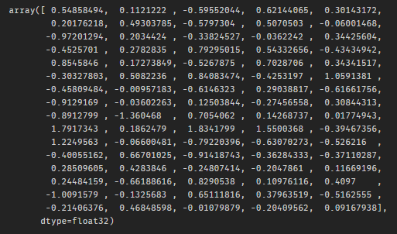
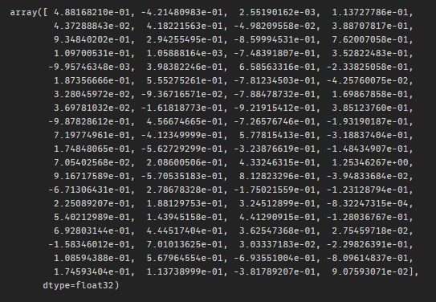
User Input:
I want a big and cozy room and a nice house. It must be near the downtown area for easy access. It must also have an amazing view of the city.
Listing (doc):
Private bedroom with amazing views of DT. Seattle in the heart of downtown. When I am home, I'll sleep on the couch in the living room. The unit is in a very nice, clean, modern bldg. Wifi available. right in the heart of downtown. close to everything you might need. wifi. cable TV. as much as you like. Yes. 4 blocks away from the train stations. should be able to walk to everything too.
Similarity Score: 0.455306
vs

Slide 17
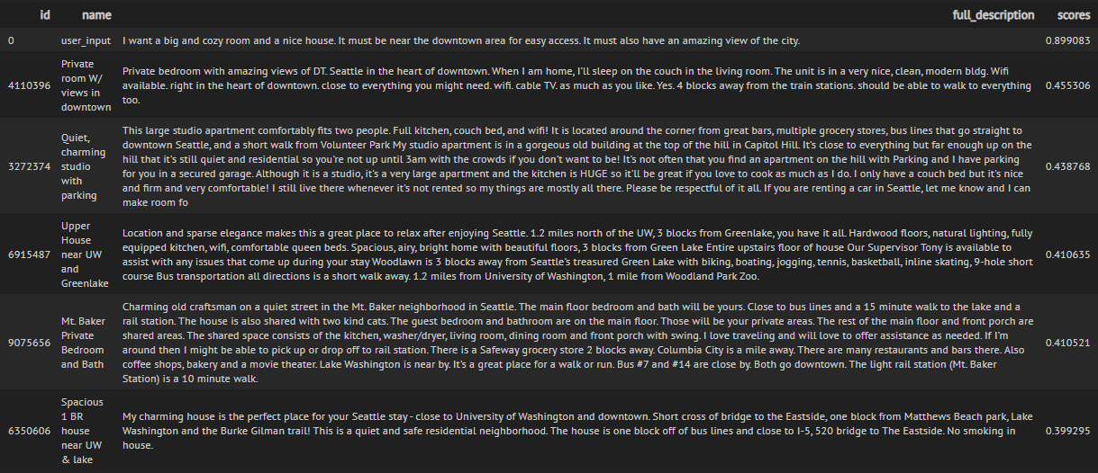
Listing_id used as unique doc_id

Slide 18
Evaluation
Doc2Vec
Better than
TF-IDF

Slide 19
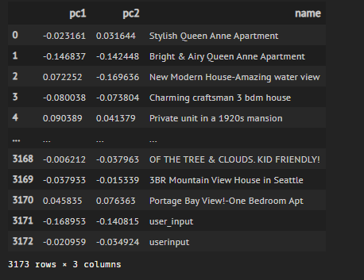
PCA
Principal Component Analysis (Unsupervised)
Dimensionality Reduction Process
Thousands of features/dimensions
2d (pc1, pc2)

Slide 20
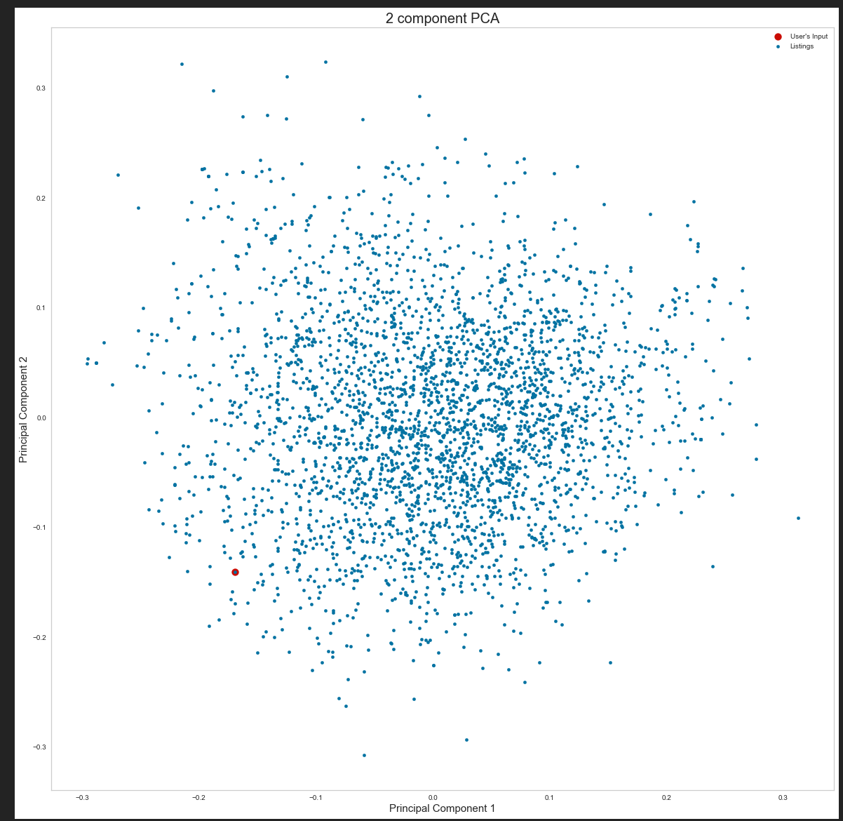
Scatter Plot of the Listings with User’s Input

Slide 21
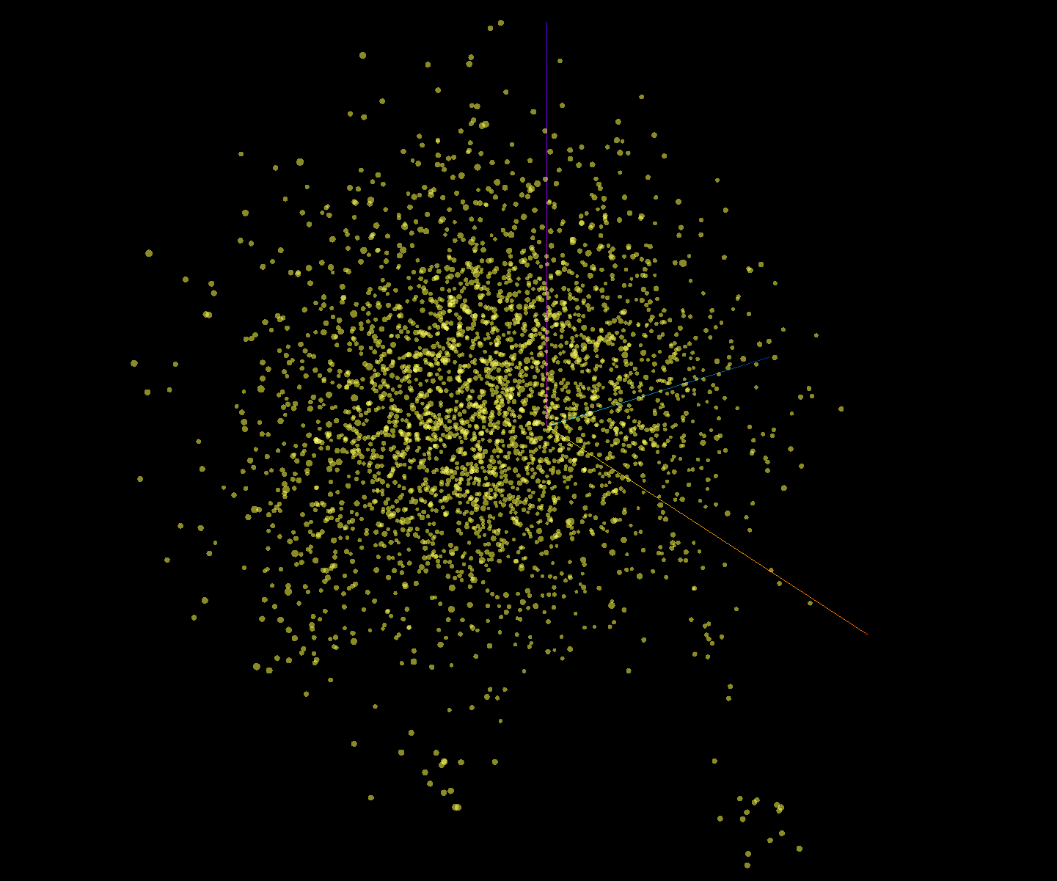
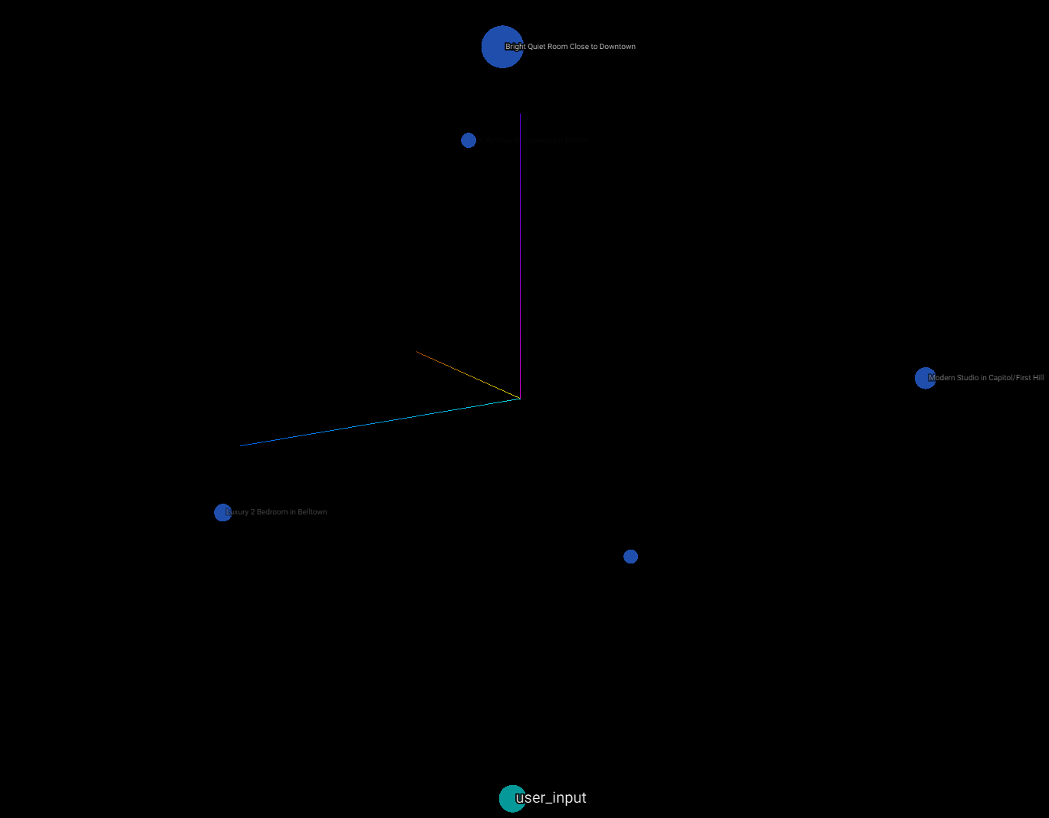
Tensorboard Embedding Projector
Interactive 3D Visualization Tool
After isolating points

Slide 24
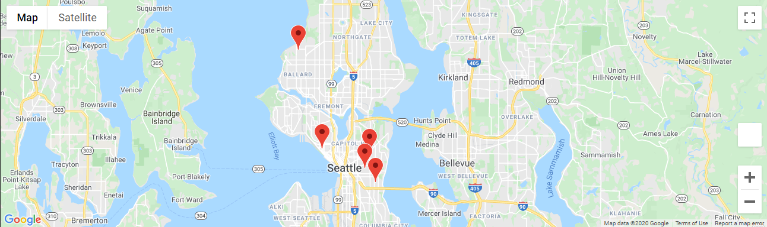
Map location of the Airbnb
System will allow to view listings on google map.

Slide 25
Conclusion
Data Preparation
Pre-Processing/Cleaning/Filter
Exploration
Visualization
Machine Learning Models
TF-IDF
Cosine-Similarity
K-NN
Doc2Vec
Results Visualization
PCA
Tensorboard Projector
GUI-App
Google Maps

Slide 26
End
Thank you and have a nice day ahead!

